Slide 1

Madison City Schools Seal of Biliteracy
Notes:
Madison City Schools current school population includes students with around 60 languages that are spoken at home. (2022)

Slide 2
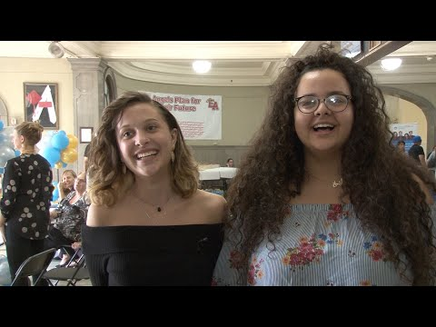
What is it?
The Seal of Biliteracy is an endorsement on your diploma.
It certifies that you have demonstrated proficiency in both English and another language.

Slide 3
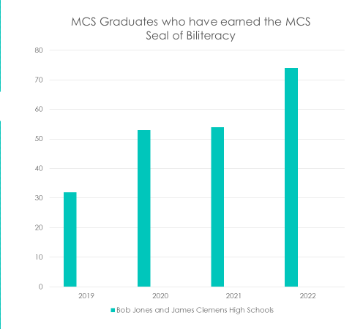
Every year, more and more MCS students earn the Seal of Biliteracy. Let’s keep it going!

Slide 4

How do I get it?
You will need to prove your proficiency in English by completing Alabama’s English proficiency requirements.
You must also prove your proficiency in another language by completing an online test, such as STAMP, or an AP exam in that language.
If you meet the minimum score on this assessment and meet the English proficiency requirements, you will earn the Alabama Seal of Biliteracy when you graduate. More details here.

Slide 5
What are the tests like?
The AVANT STAMP exam is done online. It includes an interpretive listening section, an interpretive reading section, a presentational writing section, and a presentational speaking section. The Latin STAMP exam is a reading comprehension test.
Click here for a sample STAMP test.
The AP exam is done on paper. For modern languages, it includes speaking, listening, reading, and writing. For Latin, it includes reading comprehension, analysis, and translation.

Slide 6
How can I apply?
Applications are being accepted now! The last day to apply for this semester is Friday, October 20.
To sign up, fill out the online application form, and pay the required fee amount to Ms Greene.
You will then be contacted with details about testing, which will take place at school November 13-15.

Slide 7
STAMP languages offered
Arabic
English
French
German
Hebrew
Hindi
Italian
Japanese
Korean
Mandarin (simplified or traditional)
Polish
Portuguese (Brazilian)
Russian
Spanish

Slide 8
What if my language isn’t listed?
Other tests are available for certain languages. Please see a member of the Seal of Biliteracy team for more information on how to test in your language.

Slide 9
"Learning another language is not only learning different words for the same things, but learning another way to think about things."
- Flora Lewis

Slide 10
